Slide 1
US Department of Education Office of Elementary and Secondary Education Office of Safe and Supportive Schools
School-Based Mental Health Services Grant Program (SBMH)
Year 2
Interim Performance Reporting (IPR)
and
GPRA Guidance & Tool

Slide 2
AGENDA
Housekeeping
IPR Reporting
Questions
GPRA Guidance & Tool

Slide 3
Frequency
SBMH grantees are required to submit:
Interim Performance Report (IPR) – annually
Annual Performance Report (APR) – annually, except final year
Final Performance Report (FPR) – final year only
Note: Interim Performance Reports should be submitted to the program mailbox: OESE.School.Mental.Health@ed.gov
Annual and Final Performance Reports are submitted through G5

Slide 4
REPORTING & DUE DATES
Interim Performance Report (IPR)
Due: October 11, 2024
Reporting period is January 1, 2024 – September 1, 2024

Slide 5
Key Components
Your IPR should include:
GPRA PROGRESS
A written description of your progress toward meeting identified goals and objectives during the reporting period and any preliminary GPRA data you wish to include. GPRA data is not required for an IPR. However, you should provide a description of where you are in relation to each GPRA measure at the time of the IPR report.
If your application included individual grant project goals, provide a written description of your progress with those as well.
FISCAL UPDATES & PROJECTION
A description of grant funds expended, projected spending for the rest of the grant year, any anticipated carryover and the date you expect any carryover funds to be expended. (We will provide a chart you may use if you wish; it is not required).

Slide 6
ED524B Reporting Form
The ED524B is the official reporting form used for discretionary grants at ED.
The form includes instructions and 5 distinct sections:
1-Cover Sheet
2-Executive Summary
3-Section A
4-Section B
5-Section C
Forms will be made available to you in Microsoft Word via your Federal Project Officer.
You may also access these forms and instructions online at:
http://www.ed.gov/fund/grant/apply/appforms/appforms.html

Slide 7
ED524B Reporting Form – Cover Sheet
Be sure to complete line 8, a.
The Reporting Period for this report is:
01/01/2024 – 09/01/2024

Slide 8
ED 524B: Cover Sheet
The reporting period is January 1, 2024 – September 1, 2024. These dates should not be altered.
Consult with your business office to complete sections of the report related to financial data, including budget expenditure data and indirect cost information. Make certain that the report is signed by the Authorized Representative/Certifying Official (not the Project Director).
For the data privacy question (#11), this is not required.

Slide 9
ED 524B: Executive Summary
In this section, you will provide a 1–2-page written summary that highlights progress toward meeting the project’s goals and the program’s GPRA measures, and the extent to which expected outcomes and performance measures were achieved.
This is an opportunity to “brag” and tell ED about all the great things your grant is accomplishing.
If any goals are not being met, please include information about the challenges faced by the project that are affecting project implementation and how you plan to overcome them.

Slide 10
ED 524B Section A:
Progress Status Charts: (Required for the IPR)
List the GPRA Performance Measure and Measure Type: (and Project if applicable) only
**Numerical data is not required for the IPR**
Explanation of Progress:
(Required for the IPR)
Provide a written explanation of your progress so far towards each GPRA measure and any individual project measures established in your application

Slide 11
ED 524B: Section A (Project Status)
Use the Project Status Charts to input the Performance Measure and Measure Type (GPRA or Project). If you wish, you may input data, but it is not required for the IPR.
Use the Explanation of Progress sections to explain the progress you have made on each of the GPRA measures and any individual grant measures you may have included in your application.
If necessary, you may create multiple pages of Section A.

Slide 12
SBMH GPRA Overview
New Hires
Retained
Student/Provider Ratio
Attrition
Students Served
CP1: Diversity

Slide 13
Key Definition
Unduplicated: Counts for GPRAs 1, 2, and 3 should be unduplicated. Thus, if you counted a provider toward a GPRA in your Year 1 APR, they should not be counted toward that same GPRA in the Year 2 APR.

Slide 14
GPRA 1: New Hires
The unduplicated, cumulative number of new school-based mental health services providers hired for each LEA with demonstrated need as a result of the grant.
Explanation of Progress:
List the number of providers hired using grant/matching funds in each participating LEA (e.g., LEA 1 = X hired).
It would also help to list the full-time equivalency (FTE) of the hired providers. For instance, you could list the total number of providers hired at .50 FTE and the number at 1.00 FTE for each LEA.
You could also describe any successes or challenges in hiring providers.
Notes:
The number of new providers hired across all participating LEAs.
This count should include providers hired through activities or incentives implemented using grant or matching funds.
Note: It is not possible to enter decimals into Section A within G5/G6. Therefore, round down to the nearest whole number when entering information into the table depicted above. Then, report the exact decimal number in the Explanation of Progress.
For example, if you hired two 1.0 FTE providers and one 0.5 FTE provider, enter “2” into the table while specifying you hired “2.5” providers in the Explanation of Progress.

Slide 15
GPRA 1: Example
SBMH Providers | Year 1 | Year 2
Jane | New Hire
Alex | New Hire
Jaquon |  | New Hire
Sherman |  | New Hire
Eliza |  | New Hire
GPRA 1 | 2 | 3

Slide 16
GPRA 2: Retained
The unduplicated, cumulative number of school-based mental health services providers retained in LEAs with demonstrated need as a result of the grant.
Explanation of Progress
Note which activities or strategies were used to support retention. Examples might include retention bonuses, professional development opportunities, and mentorship programs.
Notes:
The number of providers who were under contract in Year 1 and returned in Year 2.
Providers counted in this number should be those funded through the grant or matching funds or who were retained through activities or strategies funded through the grant or matching funds.

Slide 17
GPRA 2: Example
SBMH Providers | Year 1 | Year 2
Amina | New Hire | Retained
Kai | New Hire | Retained
Luca | New Hire | Left Position
Sofia |  | New Hire
James |  | New Hire
Nia |  | New Hire
Ravi |  | New Hire
GPRA 2 | 0 | 2

Slide 18
GPRA 3: Student/Provider Ratio
The ratio of students to school-based mental health services providers for each LEA with demonstrated need served by the grant, and the numbers of school-based mental health services providers and students used to calculate the ratio.
Explanation of Progress
List the ratio of students to providers within each participating LEA (e.g., LEA 1 = A/B).
Notes:
Report the ratio of students to providers across all participating LEAs: student enrollment (A)/providers(B) = A/B. For example, if there are 3,249 students and 12 providers across the participating LEAs, the ratio would be 3,249/12.
Note: G5/G6 will automatically calculate other data entries (e.g., percent) when entering ratio information. Only input the ratio information and ignore any other automatic inputs.

Slide 19
GPRA 3: Example
 | Year 1 |  | Year 2
SBMH LEAs | Students | Providers | Students | Providers
Pine Ridge Unified School District | 14,500 | 45 | 14,600 | 47
Cedar Valley Public Schools | 8,200 | 28 | 8,400 | 26
Maple Grove School District | 11,300 | 34 | 11,400 | 35
Blue River Educational District | 9,700 | 30 | 9,700 | 30
GPRA 3 | 43,700/137 |  | 44,100/138

Slide 20
GPRA 4: Attrition
The attrition rate of school-based mental health providers for each LEA with a demonstrated need that is participating in the grant.
Explanation of Progress
Provide the total number of providers at the start of the reporting period and the number that left during the reporting period.
Also, report the total number of providers for each LEA at the beginning and the end of the reporting period.
Finally, if available, list the reasons for attrition.
Notes:
Report the number of school-based mental health services providers who left their position across the participating LEAs within this reporting period.
If a provider left their position within this reporting period but previously worked in multiple schools or LEAs participating in the grant, you should only count the provider once.
If a provider left their position and that position was replaced within this reporting period, the previous provider should still be counted under GPRA 4. The new provider should be counted under GPRA 1.

Slide 21
GPRA 4: Example
SBMH Providers | Year 1 | Year 2
Ayseha | New Hire | Retained
Carlos | New Hire | Retained
Ming | New Hire | Left Position
Amara |  | New Hire
Dmitri |  | New Hire
Sofia |  | New Hire
Khaled |  | New Hire, but then Left Position
GPRA 4 | 0 | 2

Slide 22
GPRA 5: Students Served
The total number of students who received school-based mental health services as a result of the grant.
Explanation of Progress
Describe what services were provided and how grant or matching funds supported them.
Notes:
Report the number of students who received school-based mental health services within this reporting period due to the grant. These services could include Tier 1 (whole school), Tier 2 (small group), or Tier 3 (individual) practices.
The GPRA 5 count does not need to be unduplicated like some of the other GPRAs.
Thus, if a student received services in Year 1 and was counted toward GPRA 5, they can still be counted under GPRA 5 in the Year 2 APR if they also received services in Year 2.

Slide 23
GPRA 5: Example
SBMH LEAs | Year 1 | Year 2
Willow Creek Independent School District | 1,200 | 1,450
Redwood Hills School District | 900 | 1,100
Silver Lake Educational District | 1,050 | 1,300
Oakwood Unified School District | 1,300 | 1,500
GPRA 5 | 4,450 | 5,350

Slide 24
GPRA 6: Diversity
Competitive Preference Priority 1
To meet this priority, applicants must propose a plan to increase the number of credentialed school-based mental health services providers in LEAs with demonstrated need who are from diverse backgrounds or who are from communities served by the LEAs with demonstrated need.

Slide 25
GPRA 6: Diversity
For grantees that addressed competitive preference priority 1, the number of such grantees that met their goal of increasing the diversity of school-based mental health services providers.
Enter 999 for raw target and actual numbers
Explanation of Progress
Indicate whether you intended to address this performance measure (Yes/No).
Also, specify whether you met your annual target goal for increasing the diversity of school-based mental health service providers in participating LEAs (Yes/No).
Finally, please share how you defined diversity and provide information related to hired providers.
Notes:
The MHSP program office does not require that grantees provide numerical information for GPRA 6. Rather, they ask grantees to provide information in the Explanation of Progress section, as described below.
However, G5/G6 requires grantees to provide numerical information in the Section A tables for GPRA 6. Therefore, the SBMH program office instructs grantees to input "999" in the raw number cells for both target and actual performance data.

Slide 26
GPRA 4: Example
SBMH Providers | Year 1 | Year 2
Kwame | Underrepresented Group
Leila | Underrepresented Group
Santiago | Underrepresented Group
Hanae | Underrepresented Group
Mark |  | Not Underrepresented Group
Stephanie |  | Not Underrepresented Group
Nia |  | Underrepresented Group
Jerome |  | Underrepresented Group
GPRA 6 | 999 | 999

Slide 27
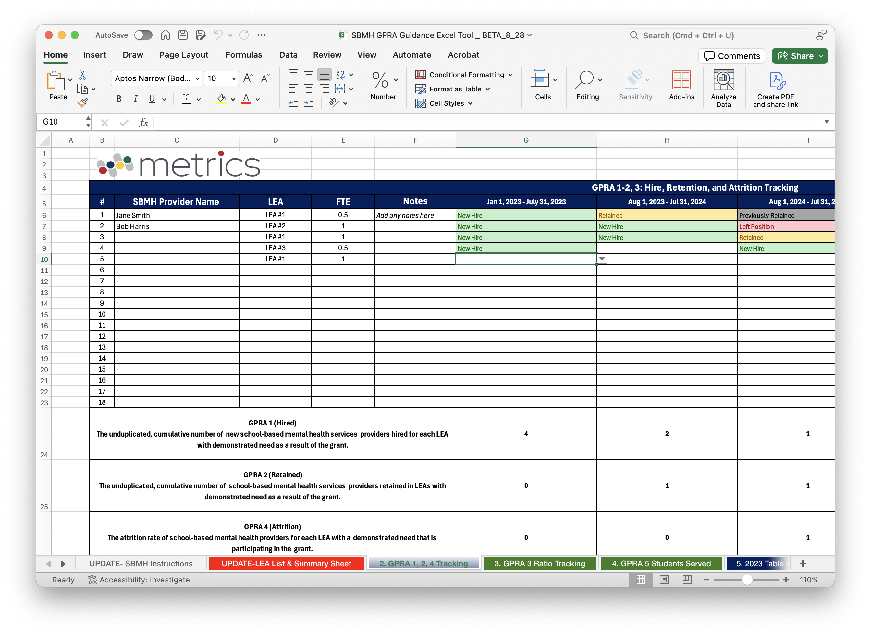
GPRA Guidance Tool

Slide 28
GPRA Guidance Tool

Slide 29
ED 524B Section B
You are to fill out Section B (Budget) in your IPR and include the Federal match information
You are to include any expected carryover and when you anticipate it will be spent.
*We will provide optional budget charts to you if you wish to add them. They are not required and are not included on the ED 524B form.

Slide 30
ED 524B: Section B
You will use this section to discuss all spending per ED budget category, projected spending for the remainder of the grant year, and any anticipated carryover.
If you expect to have any carryover by the end of the budget period (December 31, 2024), you will use Section B to discuss how much funding you anticipate remaining as carryover and why you believe those funds will not be expended by the end of the budget period.
If you identified expected carryover funds, indicate the amount as well as how you plan to use the carryover funds in the next budget period (Year 3). In addition, it is important to provide the date you expect the funds to be expended. This is considered when determining your Year 3 continuation award.

Slide 31
ED 524B: Section B
If you have cost-savings or anticipated carryover funds, you may fold those funds back into approved budget line items in your approved budget to repurpose the funds and reduce your carryover.
You may request to do so via an email to your Federal Project Officer for approval prior to your IPR due date. Approved budget transfers can be explained in your IPR Section B. If you would like to request approval, do not make the request in the IPR; simply state that you will send in a request to your FPO.

Slide 32
ED 524B: Section C
For the IPR, this section is not mandatory but can be used to share any important grant information that was not represented in the other sections.
For the APR, this section will be used to describe your progress towards the program requirements for the SBMH grant described in the Notice Inviting Applications (NIA). We will share more about this in the coming weeks and months.

Slide 33
Key IPR Requirements: Summary
Cover sheet signed by the Authorizing Representative/Certifying Official (not the Project Director), and a 1-2 page executive summary.
A description of your progress toward meeting each GPRA measure, and a description of your progress towards meeting any goals and objectives identified in your grant application that occurred during the reporting period, any preliminary GPRA measure progress achieved.
GPRA and Project Measure data are not required for an IPR. However, you are to provide a written description of where you are in relation to each GPRA measure at the time of the IPR report in the Explanation of Progress sections in Section A.
Relevant financial data, including detailed budget expenditures information for the reporting period and projected for the rest of the grant year as well as any anticipated carryover funds and when those will be spent.

Slide 34
Your IPR should be forwarded to the SBMH Program Inbox no later than October 11, 2024:
OESE.School.Mental.Health@ed.gov

Slide 35
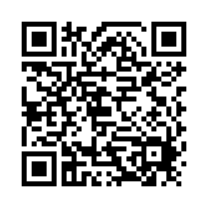
Exit Ticket
How did we do?

Slide 36
Questions?

